Slide 1

Advance Care Planning
- Something Different
Claire Henry Gina King
Chief Executive Quality Improvement Lead
The National Council for Palliative Care South West/Training Consutlant

Slide 2
Advance Care Planning
Or planning in advance your care
Is a voluntary process
Supports individuals with capacity to anticipate their future e.g. Condition
Records choices about care and treatment
Supports future decision-making in the event that capacity is lost (MCA)
Ref: Capacity, Care planning and Advance Care Planning in life limiting illness NEoLCP (2011)
Supports the opening of discussions and the opportunity to make informed choices about possible future care needs
Notes:
Definition: a process of discussion between an individual and their care provider irrespective of their discipline
Supports future decision-making in the event that capacity is lost – for those responsible for their care and treatment

Slide 3
Key Terms
Capacity: Only those who have capacity can participate in Advance Care Planning
Care Planning: embraces the care of people with & without capacity to make decisions
Lasting power of attorney: health & welfare – must be in persons best interests *
Independent Mental Capacity Advocates: if no family/friends or ACP
Best Interests: all circumstances & views to be taken into account
All underpinned by the Mental Capacity Act 2005
Notes:
Capacity: Only those who have capacity can participate in ACP
Care Planning: embraces the care of people with & without capacity to make decisions
Capacity: Only those who have capacity can participate in ACP
Care Planning: embraces the care of people with & without capacity to make decisions
Best Interests; for all circumstances to be taken into account, including thoses of close members and professionals
Lasting Power of Attorney; property and affairs/heatlth and welfare – spefic and made in the persons best interests
Lasting power of attorney
Independent Mental Capacity Advocates
Best Interests: circumstances & views to be taken into account, including thoses of close members and professionals

Slide 4
Advance statements
Can be verbal or written
Identifies the wishes, preferences, beliefs & values
Is not legal binding
Can be used to support best interest decision making
Ref: Capacity, Care planning and Advance Care Planning in life limiting illness NEoLCP (2011)
It allows you to state in advance what you would like or not like to happen

Slide 5
Advance Decisions to refuse treatment
Must be over 18 years
Refusing life-sustaining treatment must be in writing, signed and witnessed
Must be related to specific medical treatment
Must include terms “even if life is at risk”
Is legally binding if:
  Valid and applicable to the circumstances
  Written correctly
Ref: Capacity, Care planning and Advance Care Planning in life limiting illness NEoLCP (2011)
  It allows decisions to made in advance of what you do not want to happen

Slide 6

Its in the conversation….

Slide 7
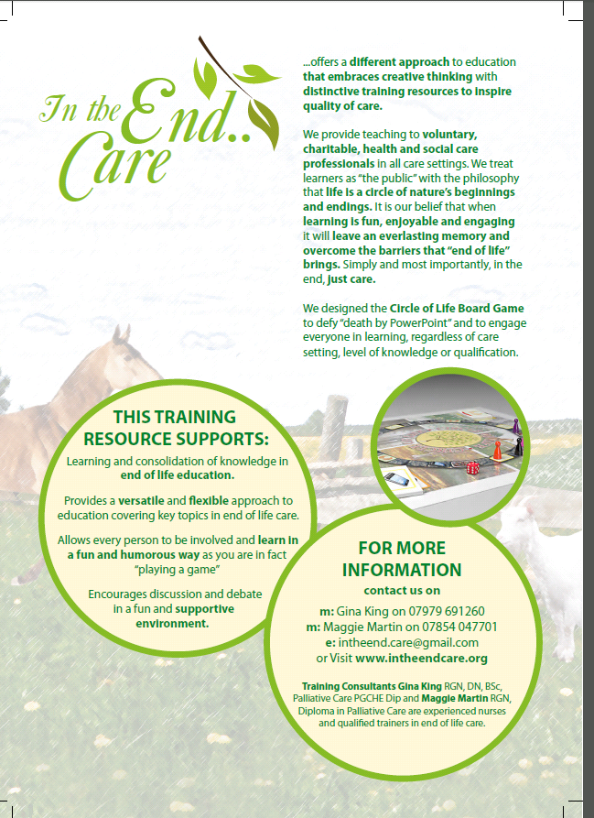
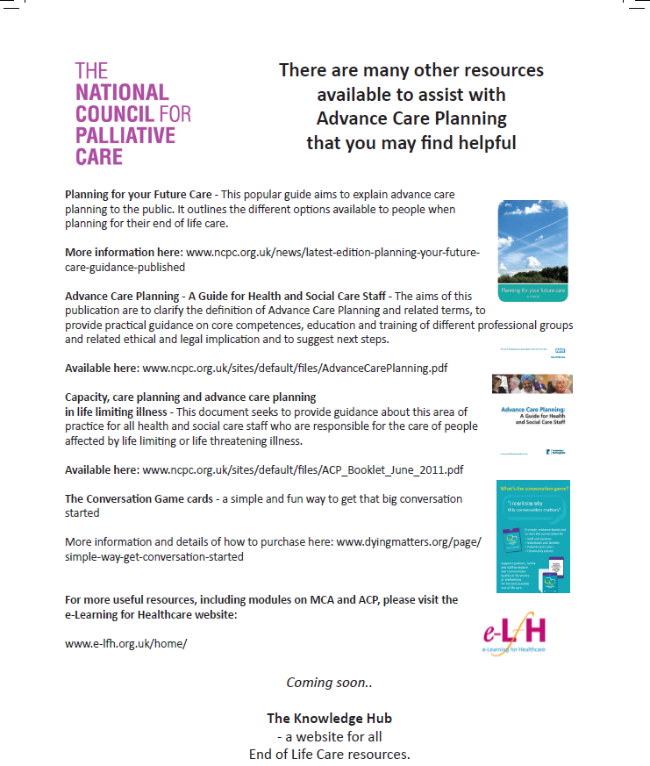
Resources

Slide 9

Lets play and learn with the

Slide 10

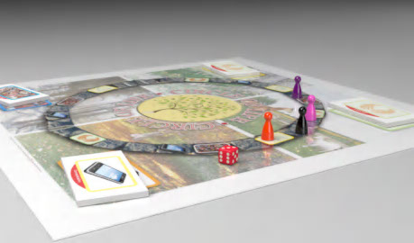
Why a Board Game?
Provides a versatile and flexible approach to education covering key topics in end of life care
Allows every person to be involved and learn in a fun and humorous way as you are in fact “playing a game”
Provokes debate and discussion
Brings everyone together to share and support their experiences

Slide 11
Four subjects within the Game
CONSISTENT TOPICS
OPTIONAL TOPICS TO CHOOSE FROM
Conversations
Advance Care Planning
Assessment
Bereavement
Cultural considerations
Last Days of Life
Spirituality
Symptom management

Slide 12
References
GSF (2008) Prognostic Indicator Guidance. London: National Gold Standards Framework.
Henry, C. & Seymour J (2007). Advance Care Planning: A guide for Health and Social Care Staff. London: The stationary Office.
King, G. (2012). Providing quality in end of life care. In Chilton, S., Bain, H., Clarridge, A. and Melling, A. A textbook of Community Nursing. pp 198-213.
NEoLCP (2011) Capacity, Care planning and Advance Care Planning in life limiting illness NEoLCP.
Vernon, M. (2013). How to have a good death. Saturday Telegraph Magazine.

Slide 13
For further information
Contact
Gina King - gina.king1@nhs.net
Claire Henry – c.henry@ncpc.org.uk
www.ncpc.org.uk
www.dyingmatters.org
http://www.intheendcare.org.uk/circle-of-life-board-game.html

